Slide 1
Fantasy Cricket Using Python
Summer Training Project
Vikrant Singh Jamwal
B. Tech IT (7th Semester)
Roll No: 03116401517

Slide 2
All about the Training
The Training is divided into Four Parts:
Programming with Python
GUI using Python
Database Connectivity
Final Project

Slide 3
Programming with python
Here, I learned about the features of the python language. Similarities and differences between Python and other Languages like Java and C++. Data variables, types, loops, conditions, features of OOPS and syntax of the python language were also taught.
There are many features in Python, some of which are:
Easy to code:
Python is a high-level programming language. Python is very easy to learn the language as compared to other languages like C, Java, etc. It is also a developer-friendly language.
Free and Open Source:
Since it is open-source, this means that source code is also available to the public. So you can download it as, use it as well as share it.

Slide 4
Object-Oriented Language:
One of the key features of python is Object-Oriented programming. Python supports object-oriented language and concepts of classes, objects encapsulation, etc.
Interpreted Language:
Python is an Interpreted Language because Python code is executed line by line at a time. like other languages C, C++, Java, etc. there is no need to compile python code this makes it easier to debug our code. The source code of python is converted into an immediate form called bytecode.

Slide 5
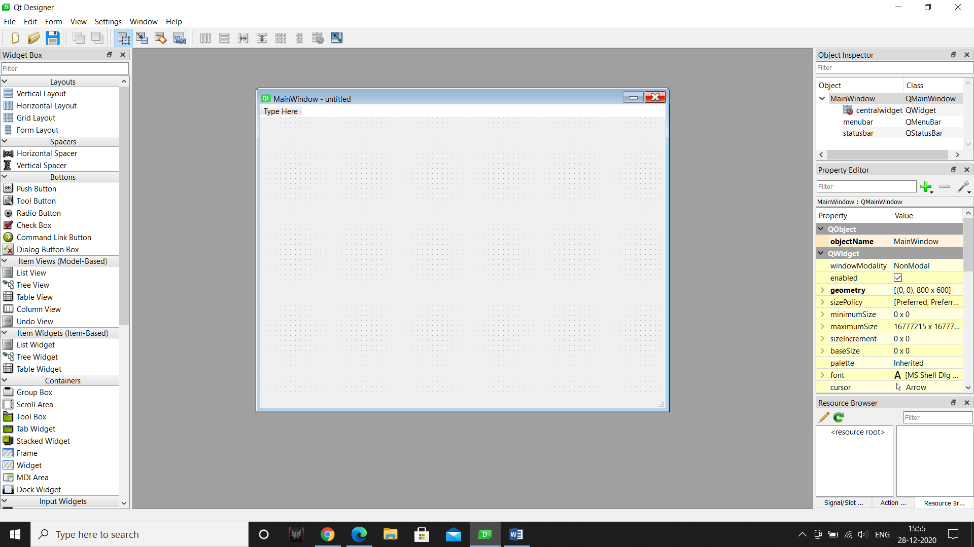
GUI with Python language
Learned to connect the user interface platform with the Python codes for creating applications.
PyQt5 was used to create the UI for the applications. With easy Drag and Drop options and widgets it helps the developer to create the front end more efficiently.

Slide 6
Database
Connected Database with Python codes. First creating the database, adding the elements using SQLite3 and then connecting with the Python codes so that data can be easily stored and read.
SQLite is an in-process library that implements a self-contained, server less, zero-configuration, transactional SQL database engine. It is a database, which is zero-configured, which means like other databases you do not need to configure it in your system.

Slide 7
Database Methods
Connect- Used to connect the database to the python file. Importing the libraries of SQLite3 and data in the Database.
Curser- Used as an object of the SQLite to execute its methods in the python file using simple SQL statements like SELECT, DELETE, WHERE, etc.

Slide 8
Project work: Fantasy Cricket
Problem Statement
It is an online game where you create a virtual team of real cricket players and score points depending on how your chosen players perform in real life matches. To win a tournament, you must try and get the maximum points and the No. 1 rank amongst other participants. Here's how a Fantasy Cricket game may look like.

Slide 9
Approach
First creating the database and the three tables required.
Then creating the User interface using PyQt5 designer and then converting those files to the Python format.
Then writing some methods to connect different windows together to make a working multipage application.

Slide 10
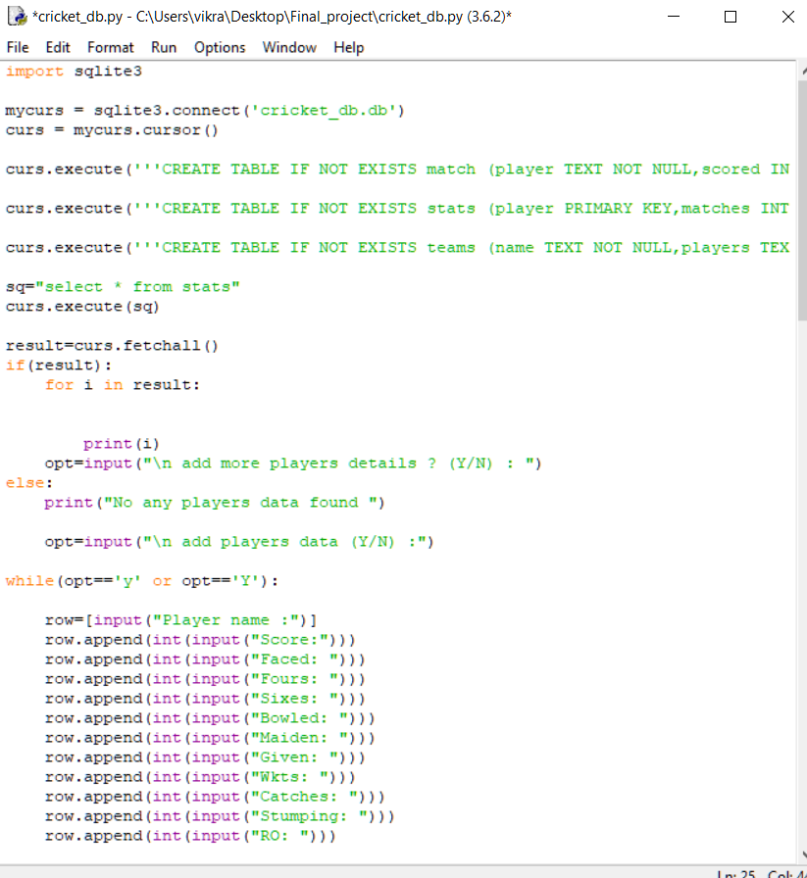
Making database
Database is created using sqlite3 package in python.
First three tables are created and the data is added to it.
Output has been then generated for adding more data to the user.

Slide 11
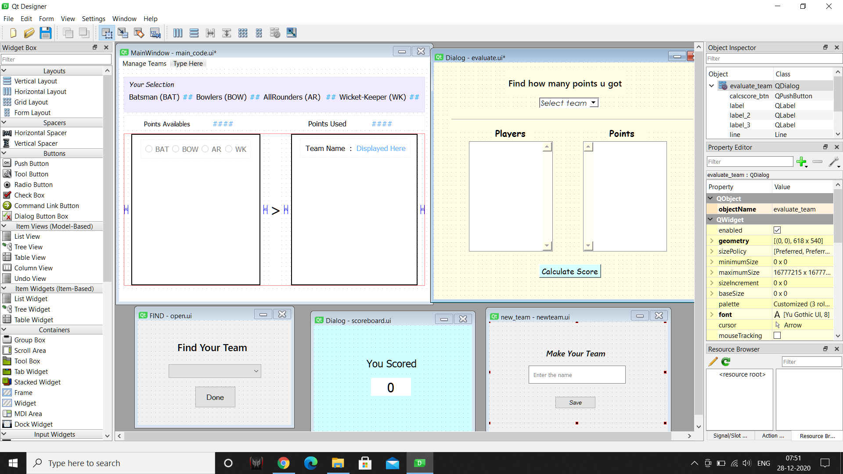
GUI using PyQt designer

Slide 12
These are the complete 5 windows which is required to create the application.
First, main window of the application- presents the Menu bar for the user to perform an action.
Second, New team window- for making new team by giving the name of the team and selecting the players to be kept in that team considering the given conditions.
Third, Open window- to open the Already made team for updating or reviewing.
Fourth, Evaluation window- provides with 2 frames to display the team players and the points scored by them, containing a button for scorecard.
Fifth, Scorecard window- for displaying the total points acquired by the Team.

Slide 13
Final Step
This Python file the final project file where all the other windows python files are imported to connect each other using buttons clicks. Dialog boxes, error messages and each window is defined individually to create a working application.

Slide 14
THANK YOU

